Slide 1


Artificial Intelligence (Machine Learning & Deep Learning)
NAVTCC & Strings Technologies
by Salman Ahmad

Slide 2
Outline Week 3 Day 3
Introduction to numpy
1
2
Creating numpy arrays
Array attributes and methods
3
4
Operations on numpy arrays
Questions
5

Slide 3
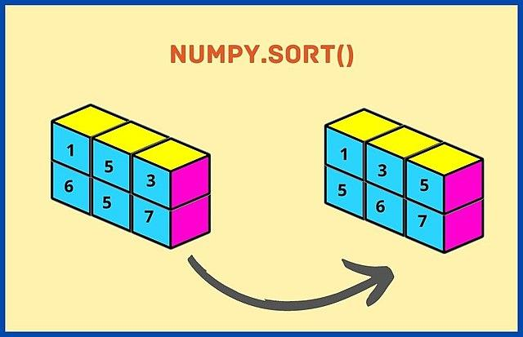
Introduction to numpy
What is NumPy?
NumPy stands for Numerical Python
A powerful Python library for:
Working with arrays
Performing mathematical & logical operations
Handling large datasets efficiently

Slide 4

Introduction to numpy
Why Use NumPy?
Faster than Python lists (thanks to C under the hood)
Supports multidimensional arrays
Comes with a huge set of vectorized operations (no need for loops)
Foundation for pandas, TensorFlow, PyTorch, Scikit-learn

Slide 5
Installing numpy
pip install numpy

Slide 6
Importing and Creating Arrays
From Python Lists
import numpy as np
# 1D Array
a = np.array([1, 2, 3])
# 2D Array (Matrix)
b = np.array([[1, 2], [3, 4]])
print(a.shape) # (3,)
print(b.shape) # (2, 2)
From np functions
import numpy as np
np.ones((2, 2))
np.zeros((2, 3))
np.full((3, 3), 7)
np.eye(3)
np.arange(0, 10, 2)
np.linspace(0, 1, 5)
From np random arrays
import numpy as np
np.random.rand(2, 3) # 2x3 matrix
np.random.randint(1, 10, size=(3, 3))
np.random.randn(3) #(mean=0, std=1)
np.random.seed(42)
np.random.randint(1, 10, size=(3,3))

Slide 7
Numpy vs python list
Feature | Python List | Numpy Array
Speed | Slower | Faster
Type Consistency | Mixed | Same for all elements
Operations | Manual | Vectorized
Broadcasting | No | Yes

Slide 8
Numpy broadcasting
What is Broadcasting?
Broadcasting allows NumPy to perform operations on arrays of different shapes
Instead of manually repeating data, NumPy "stretches" the smaller array so shapes align
Enables fast vectorized computation without loops

Slide 9
Numpy broadcasting
import numpy as np
a = np.array([1, 2, 3]) # Shape: (3,)
b = 5 # Scalar
print(a + b) # Output: [6 7 8]
#Scaler value 5 is broadcasted across the array

Slide 10
Numpy broadcasting
a = np.array([[1], [2], [3]]) # Shape: (3, 1)
b = np.array([10, 20, 30]) # Shape: (3,)
# Broadcast shapes: (3, 1) + (1, 3) => (3, 3)
result = a + b
✅ a expands across columns
✅ b expands across rows
➡️ Output shape: (3, 3)

Slide 11
Numpy broadcasting
Broadcasting Rules
NumPy compares shapes from right to left:
If the dimensions match → ✅
If one of them is 1 → ✅ stretch it (increase size)
Otherwise → ❌ error

Slide 12
Indexing and Slicing in NumPy
Basic Indexing
import numpy as np
a = np.array([10, 20, 30, 40, 50])
print(a[0]) # 10
print(a[-1]) # 50
Works like Python lists — zero-based and supports negatives.

Slide 13
Indexing and Slicing in NumPy
2D Array Indexing
b = np.array([[1, 2, 3],
[4, 5, 6]])
print(b[0, 1]) # 2 → row 0, col 1
print(b[1, 2]) # 6 → row 1, col 2
Access using [row, column]

Slide 14
Indexing and Slicing in NumPy
1D Slicing
a = np.array([10, 20, 30, 40, 50])
print(a[1:4]) # [20 30 40]
print(a[:3]) # [10 20 30]
print(a[::2]) # [10 30 50]

Slide 15
Indexing and Slicing in NumPy
2D Slicing
b = np.array([[1, 2, 3],
[4, 5, 6],
[7, 8, 9]])
print(b[0:2, 1:3]) # Rows 0-1, Cols 1-2 → [[2 3], [5 6]]
print(b[:, 0]) # First column → [1 4 7]
print(b[1, :]) # Second row → [4 5 6]

Slide 16
Indexing and Slicing in NumPy
Advanced Indexing
a = np.array([10, 20, 30, 40, 50])
idx = [0, 2, 4]
print(a[idx]) # [10 30 50]
You can index with arrays/lists of positions

Slide 17
Indexing and Slicing in NumPy
Boolean Indexing
a = np.array([10, 15, 20, 25])
mask = a > 15
print(a[mask]) # [20 25]
Use conditions to filter data efficiently

Slide 18
Numpy array functions
Array attributes and methods
reshape
max, min,
argmax, argmin
shape, dtype, size,
ndim
expand_dim, squeeze

Slide 19
Operations on numpy arrays
Copying Arrays
import numpy as np
a = np.array([1, 2, 3])
b = a.copy()
print(b) # [1 2 3]
Appending Elements
a = np.array([1, 2, 3])
b = np.append(a, [4, 5])
print(b) # [1 2 3 4 5]
Inserting Elements
a = np.array([1, 2, 4])
b = np.insert(a, 2, 3) # Insert 3 at index 2
print(b) # [1 2 3 4]

Slide 20
Operations on numpy arrays
Sorting Arrays
a = np.array([3, 1, 2])
sorted_a = np.sort(a)
print(sorted_a) # [1 2 3]
print(sorted_a[::-1]) #[3 2 1]
Removing/Deleting Elements
a = np.array([1, 2, 3, 4])
b = np.delete(a, 1) # Delete element at index 1
print(b) # [1 3 4]
Combining/Concatenating Arrays
a = np.array([1, 2])
b = np.array([3, 4])
c = np.concatenate((a, b))
print(c) # [1 2 3 4]

Slide 21
Operations on numpy arrays
Splitting Arrays
a = np.array([1, 2, 3, 4, 5, 6])
b = np.split(a, 3)
print(b)
# [array([1, 2]), array([3, 4]), array([5, 6])]

Slide 22
Practice Task
Create:
A 4×4 matrix of all ones
A 5-element array with values between 10 and 50
A 3×3 matrix of random integers between 0 and 100
Use .shape, .dtype, and .ndim to explore array properties

Slide 23
Practice Task
Create an array of numbers from 1 to 10
Insert number 99 at position 5
Remove element at index 2
Sort the array
Split it into 2 equal parts

Slide 24
Practice Task
Create an array of numbers from 1 to 10
Insert number 99 at position 5
Remove element at index 2
Sort the array
Split it into 2 equal parts

Slide 25
Practice Task
Create a 3D array of shape (2, 3, 4) with random integers
Find the mean along axis 1
Multiply the array by 3
Add a scalar and subtract another array
Transpose it to (3, 2, 4) and sum along axis 0

Slide 26
Practice Task
Create a 3D array of shape (2, 3, 4) with random integers
Find the mean along axis 1
Multiply the array by 3
Add a scalar and subtract another array
Transpose it to (3, 2, 4) and sum along axis 0

Slide 27

Questions?
"He who asks a question is a fool for a minute; he who does not remains a fool forever." – Confucius

